Slide 1
DATA VISUALIZATION WITH TABLEAU
NAME – AJAY.A
CLASS- BBA DATA SCIENCE
REG NO- RA2351103010021

Slide 2
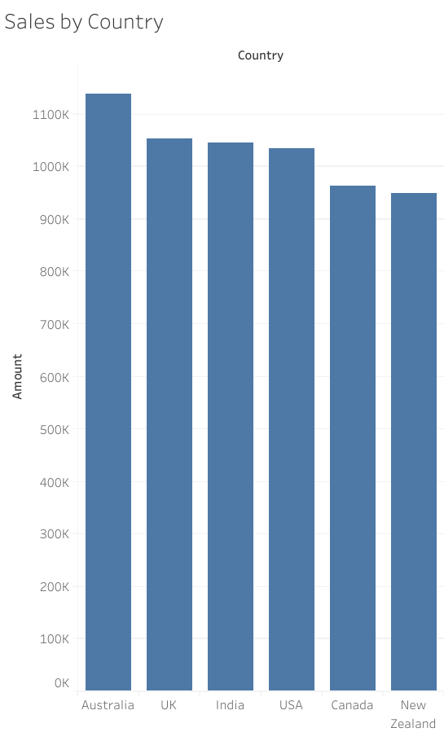

Slide 3
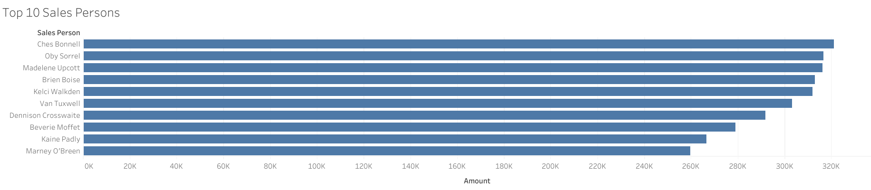

Slide 4
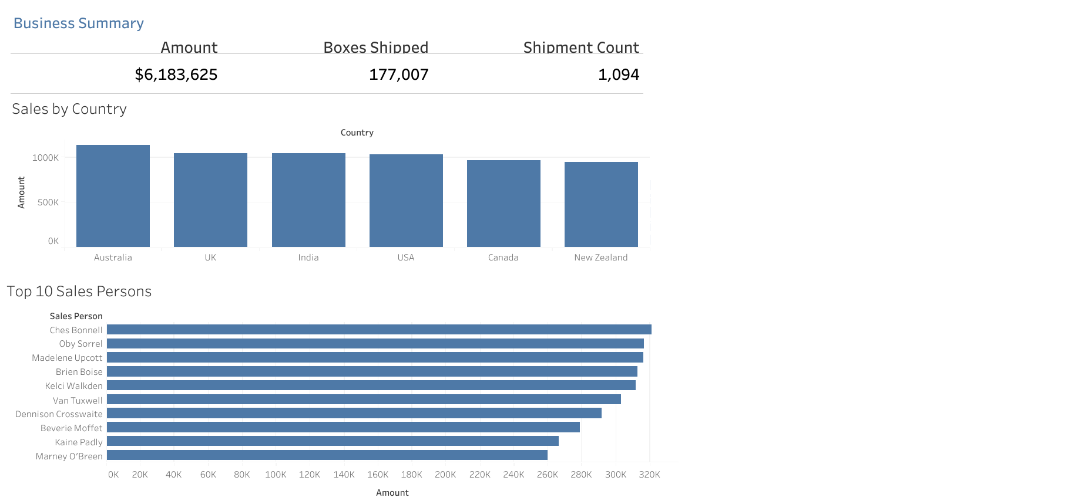

Slide 5
